Slide 1
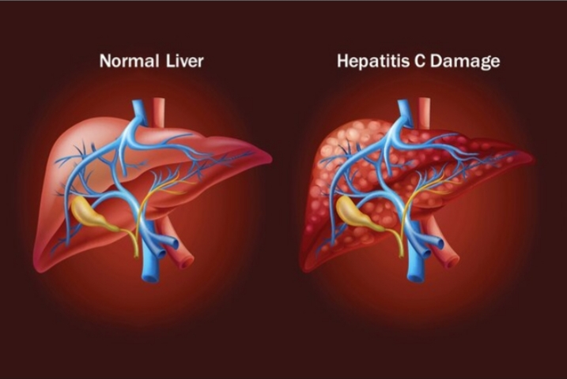
Type C Hepatitis

Slide 2
Content
INTRODUCTION
DEFINITION
CAUSAL AGENT
EPIDEMIOLOGY
TRANSMISSION
PATHOGENESIS
LIFE CYCLE
CLINICAL FEATURES
LABORATORY DIAGNOSIS
PROPHYLAXIS
TREATMENT

Slide 3
INTRODUCTION
Attempts to identify the group of ‘non- A non-B’ viruses by experimental infection in chimpanzees led to the discovery of hepatitis C virus (HCV).
It is a main cause of HCV liver cancer.

Slide 4
Definition
Hepatitis C is a liver disease caused by hepatitis C virus. It can cause both acute and chronic hepatitis.

Slide 5
CAUSAL AGENT- Hepatitis C Virus
Size -: HCV is a 50-60nm virus
Genetic material-: linear single stranded RNA genome
Core-: Genome enclosed within a core.it is made up of protein.
Nucleocapsid-:The capsid or core with the enclosed nucleic acid is known as nucleocapsid.
Envelope-:
Envelope made up of glycoproteins E1 and E2
It is involved in viral attachment and entry into the cell
Lipid membrane -: It is derived from host.
Fig. Structure of HCV

Slide 6
EPIDEMIOLOGY
Hepatitis C occurs worldwide.
Host-: human
Source of infection-: carriers
High risk of infection-: 1)injectable drug abusers 2)transplant recipients 3)immunocompromised persons

Slide 7
TRANSMISSION
Blood transfusion
Contact with infected blood or blood product
Sexual transmission is less important
From mother to baby
It is not spread through breast milk,food, water or casual contact.

Slide 8
PATHOGENESIS
HCV
Enters into liver
Replicate in hepatocytes
Persistence of the infection leads to chronic hepatitis and hepatocellular carcinoma

Slide 9
LIFE CYCLE

Slide 10
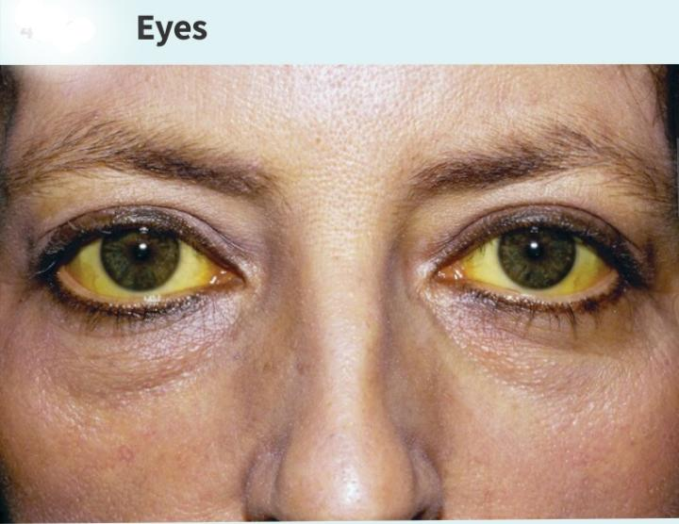
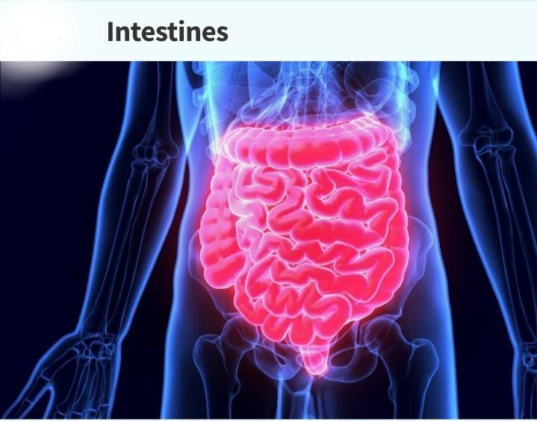
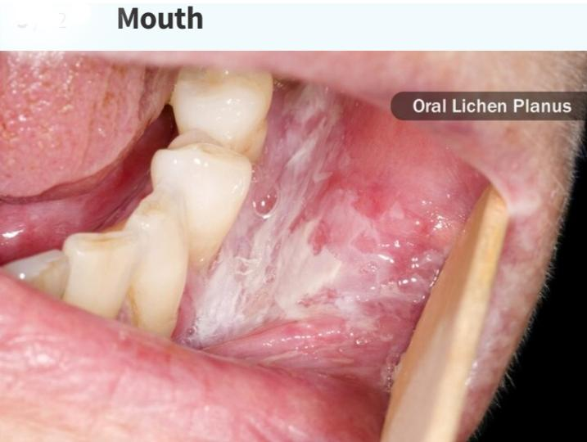
CLINICAL FEATURES
Fever, fatigue, decreased appetite, nausea, vomiting, abdominal pain, dark urine, grey coloured feces,joint pain,jaundice etc.

Slide 11
Laboratory diagnosis
Serological test-:The standard method of diagnosis is antibody detection by ELISA.
Nucleic acid test-:Identification of HCV RNA in blood provides more sensitive and specific results within a few days of exposure to HCV.
Molecular method-:PCR and branched DNA assay

Slide 12
Prophylaxis
General prophylaxis
Safe and appropriate use of health care injection
Blood screening
Hygiene
Health education
Specific prophylaxis – No specific active and passive immunizing agent is available

Slide 13
Treatment
Prolonged treatment with interferon alpha,either alone or in combination with antiviral agents like ribavirin has been reported to be useful in some cases.
Therapy-:Recommended by WHO is pan-genotypic direct-acting antivirals(DAAs)

Slide 14
References
Medical Microbiology by Anantnarayan
https: //www.hepatitisc.uw.edu
https: //www.sciencedirect.com
https: ://www.researchgate.net
https: //www.webmd.com
https: //www.who.int

Slide 15
Thank you

